Slide 2
Cloud Services Libraries & Cloud Request Processor Accelerator (*MVP available for AWS cloud)
Oct 2019

Slide 3
Agenda
Cloud Services Libraries
Cloud Request Processor Accelerator
Case Study | IVR Product using Cloud Accelerator and Twilio
POC | Use Case | Real Time Streaming Ingestion & Integration

Slide 4
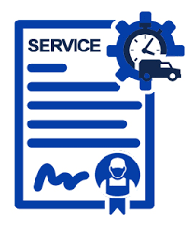
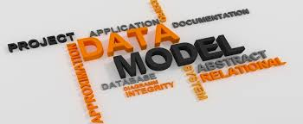


Key Features / Benefits
1
2
3
4
Defined set of contracts for
Cloud Services: a java class whose contract is exposed through a Java interface
Request Processor: encapsulate business logic
Transformer: transform inbound request format i.e. JSON/XML to internal Data Models and vice-versa
CloudFactory: creates Cloud Services specific to a Cloud Providers i.e. AWS, Azure, etc
Data Models – Service specific data models for data exchange between Cloud Services
Simple and easy to use
Cloud Agnostic – separate implementation of these contracts per cloud provider
Interoperability across cloud providers
Write once, run anywhere
MVP (Cloud Services, Transformer and CloudFactory) available for AWS cloud
Work under-way for Azure MVP

Slide 5
Cloud Services Libraries
Key Features / Benefits
1
2
3
4
Defined set of contracts for
Cloud Services: a java class whose contract is exposed through a Java interface
Request Processor: encapsulate business logic
Transformer: transform inbound request format i.e. JSON/XML to internal Data Models and vice-versa
CloudFactory: creates Cloud Services specific to a Cloud Providers i.e. AWS, Azure, etc
Data Models – Service specific data models for data exchange between Cloud Services
Simple and easy to use
Cloud Agnostic – separate implementation of these contracts per cloud provider
Interoperability across cloud providers
Write once, run anywhere
MVP (Cloud Services, Transformer and CloudFactory) available for AWS cloud
Work under-way for Azure MVP

Slide 6
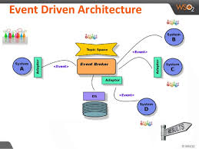
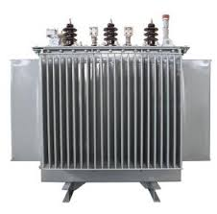
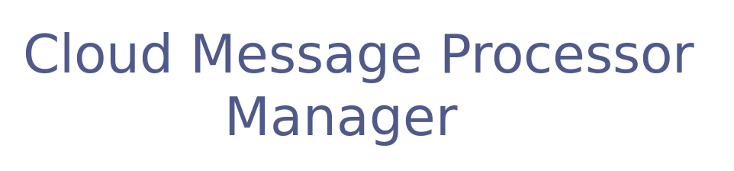

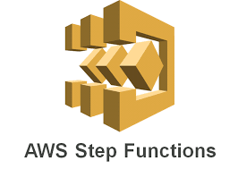
Cloud Request Processor Accelerator
Key Features / Benefits
1
2
3
4
5
Business Logic
Infrastructure Services
Request Processor Accelerator
De-couple Cloud Implementation from Business Logic
Easy to use, leverage Cloud Libraries; developer re-skilling to Cloud NOT required.
Well suited for use case
Event-Driven architecture i.e. just configure Accelerator as interceptor
Data Pipeline: write your own transformer and processors
Transformer: Write your own transformer(i.e. JSON/XML/CloudEvent Object/etc) to transform request format to Cloud Libraries internal data model and vice-versa.
Core Component does following
Required Configuration: business logic class name, required Cloud Services, Transformer, additional configuration
Instantiate CloudRequestProcessor (business logic contract), Transform external request to internal format, Inject requested Cloud Services, configured properties, Execute it and Transform response to external format
MVP available for AWS Cloud Provider
Work underway for Azure

Slide 7
Demo

Slide 8
Case Study | IVR Product
Business Requirements:
Domain - Hiring
Requirement - Automate candidate and recruitment team interaction to yield multi-folds benefits
Reduce no-shows by
Preempting no-show by automating candidate attendance check via IVR.
Give recruitment team sufficient lead time to act on potential no-shows and convert them to showed
Enhance candidate experience by seeking and capturing candidate inputs around attendance or help needed around transport or rescheduling
Reduce hiring as well interview panel efforts by optimizing interview schedule process
Cloud Message Accelerator Benefits:
Expedited development – MVP was built in three weeks with one senior java developer
No developer re-skilling to AWS Cloud skill required. Developer is to focus on writing business logic only.
Simple and easy to use accelerator and cloud libraries
Outcomes
No-show reduced by 40%
Optimized hiring team and interview panel efforts
Enhanced candidate experience

Slide 9
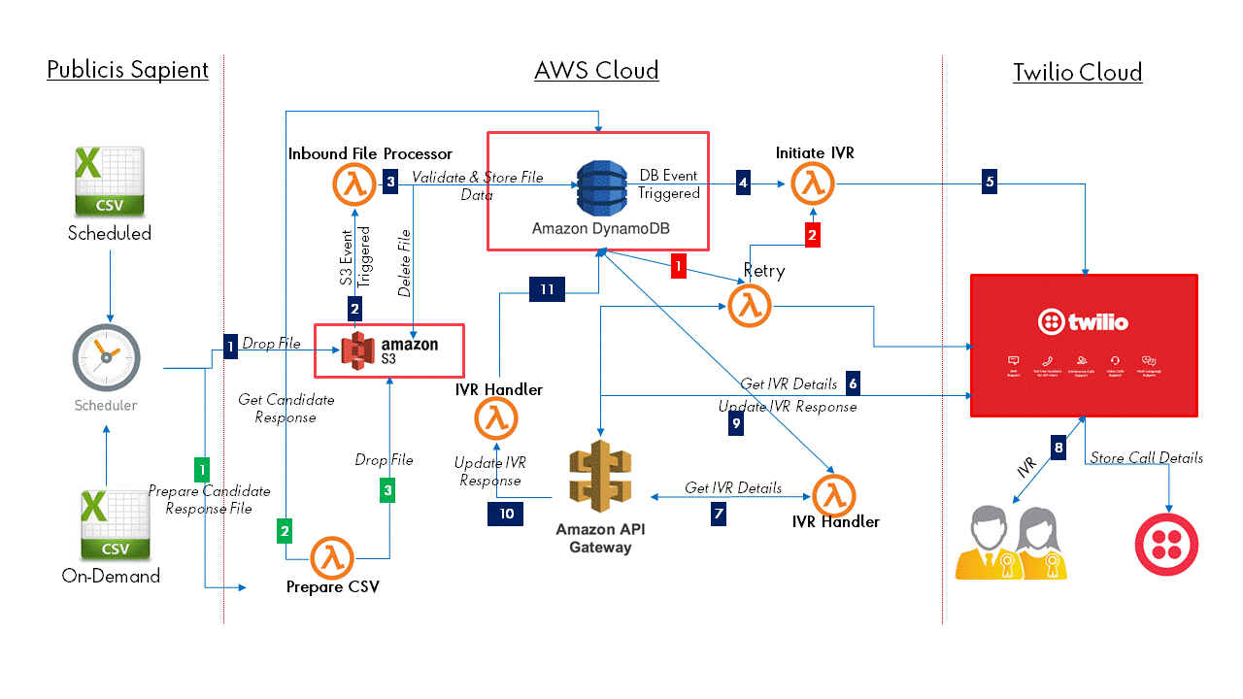
IVR Solution| Architecture Diagram

Slide 10
POC | Use Case | Real Time Streaming Ingestion & Integration
Use Case:
Ingest vast amount of data through multiple source systems and process it in real-time. Each data record follow through below stages
Ingestion:
Ingest and store raw data in durable data store for future references.
Perform quick validation on data quality checks such as schema validation and post validated message to success/exception queue.
Process:
Initiating a workflow based orchestration services to process validated data record in real-time and post processed data record either in success queue for further consumption or in exception queue for exception handling
Consumption:
Consumers can consume this message for further processing
Continuously update client dashboard with real-time status

Slide 11
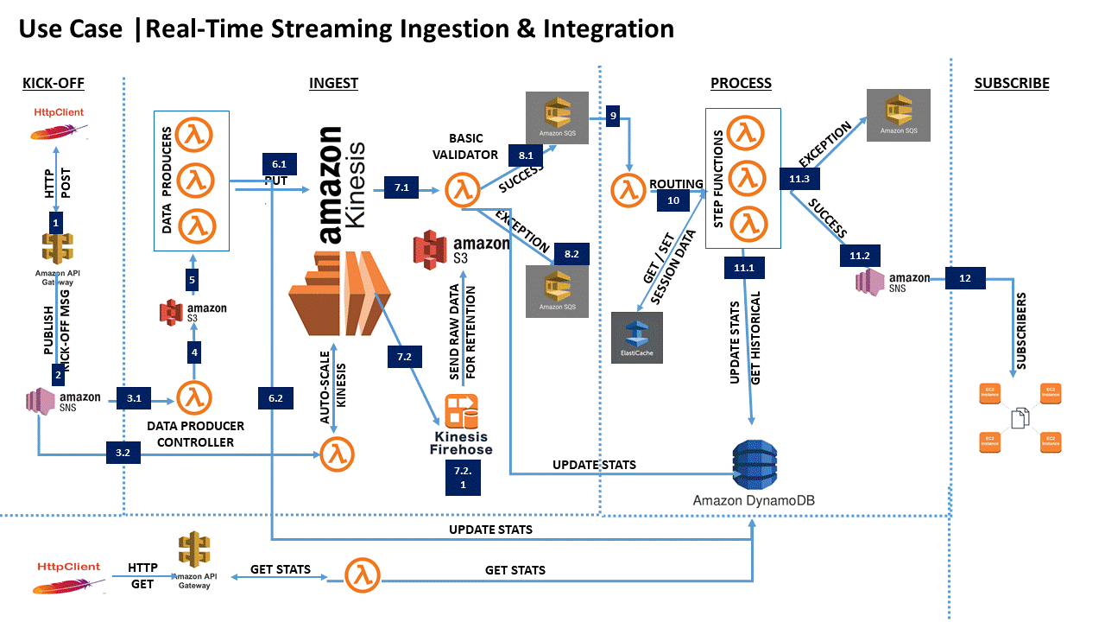
POC | Solution Architecture

Slide 12

Please send your queries to:
Brijesh Sharma
Brijesh.sharma1@publicissapient.com
+91 981 052 5110
Link

Slide 13
Appendix

Slide 14
Cloud Accelerator – Decoupled Stages
Interceptor
Purpose - Intercept all inbound request of any format and route it to cloud accelerator along with all configuration
Action – can be configured as a listener, http endpoint rest service, etc
Transformer
Purpose – transform inbound request into cloud accelerator data model “CloudRequests”
Action – write your own transformer, configure it with accelerator for transforming inbound request
Processor
Purpose – process “CloudRequests” leveraging CloudServices injected by CloudAccelerator and return “CloudResponse”
Action:
Write your own processor, which can represent business logic/function
Configure your processor with cloud accelerator. Define CloudFactory and CloudService names, which cloud accelerator will use it to create and inject cloud services.
Example. Business logic, which uses CloudService NoSQLDBService, can configure AWSDynamoDB service for persistence. The same processor can later be reconfigured on Azure with Azure CosmoDB service for persistence without making code change
Transform Outbound Response
Purpose – transform CloudResponses into outbound response format.
Action – write your own transformer, configure it with accelerator for transforming CloudResponses

